Slide 1
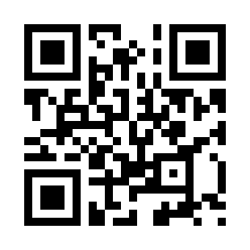
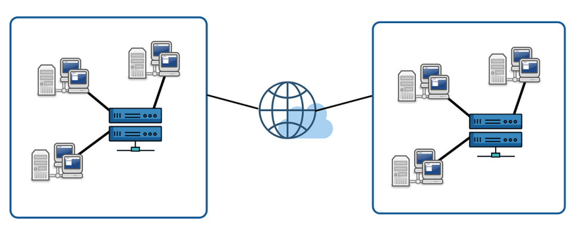
Lab 06 - Distributed Architecture and Programming
https://bit.ly/479QwI8

